Slide 1
Unit : II
Sulaxan Jadhav

Slide 2
Introduction to Android
History of Android
Market Share and Popularity
Versions of Android (brief overview)
Features of Android

Slide 3
History of Android
Founded by Android Inc. in 2003
Android was originally developed by Android Inc., a company founded by Andy Rubin, Rich Miner, Nick Sears, and Chris White.
The company aimed to create an advanced operating system for digital cameras but later shifted focus to mobile devices.
Acquired by Google in 2005
Google acquired Android Inc. in 2005 for an undisclosed amount, recognizing its potential for the mobile market.
The acquisition was a strategic move to enter the mobile space and challenge existing players like Apple.

Slide 4
First Commercial Android Device: HTC Dream (2008)
The HTC Dream, also known as the T-Mobile G1, was the first commercial device powered by Android.
Released in October 2008, it featured a touchscreen interface and a slide-out QWERTY keyboard.
Major Milestones:
Launch of Android Market (2008): The precursor to Google Play, it allowed users to download and install apps on their Android devices.
Rapid Adoption by Major Device Manufacturers: Companies like Samsung, HTC, LG, and Motorola quickly adopted Android, lealeading to a diverse range of devices and accelerating Android's market penetration.

Slide 5


Slide 6
Market Share and Popularity

Slide 7
Android Holds the Largest Market Share in the Mobile OS Market (Over 70%)
ndroid's open-source nature and support from Google have allowed it to become the most widely used mobile operating system.
As of the latest statistics, Android holds over 70% of the global mobile OS market share, surpassing iOS and other operating systems.
Wide Adoption Across Various Devices
Android's versatility has led to its integration into a wide range of devices beyond smartphones, including:
Tablets
Smart TVs
Wearables (e.g., smartwatches)
Automotive systems (Android Auto)
IoT devices

Slide 8
Strong Presence in Emerging Markets Due to Diverse Device Price Points
Android devices are available at a wide range of price points, from budget-friendly to premium models.
This affordability makes Android highly popular in emerging markets, where cost is a significant factor for consumers.
Local manufacturers in countries like China and India produce a variety of Android devices, further driving adoption.

Slide 9
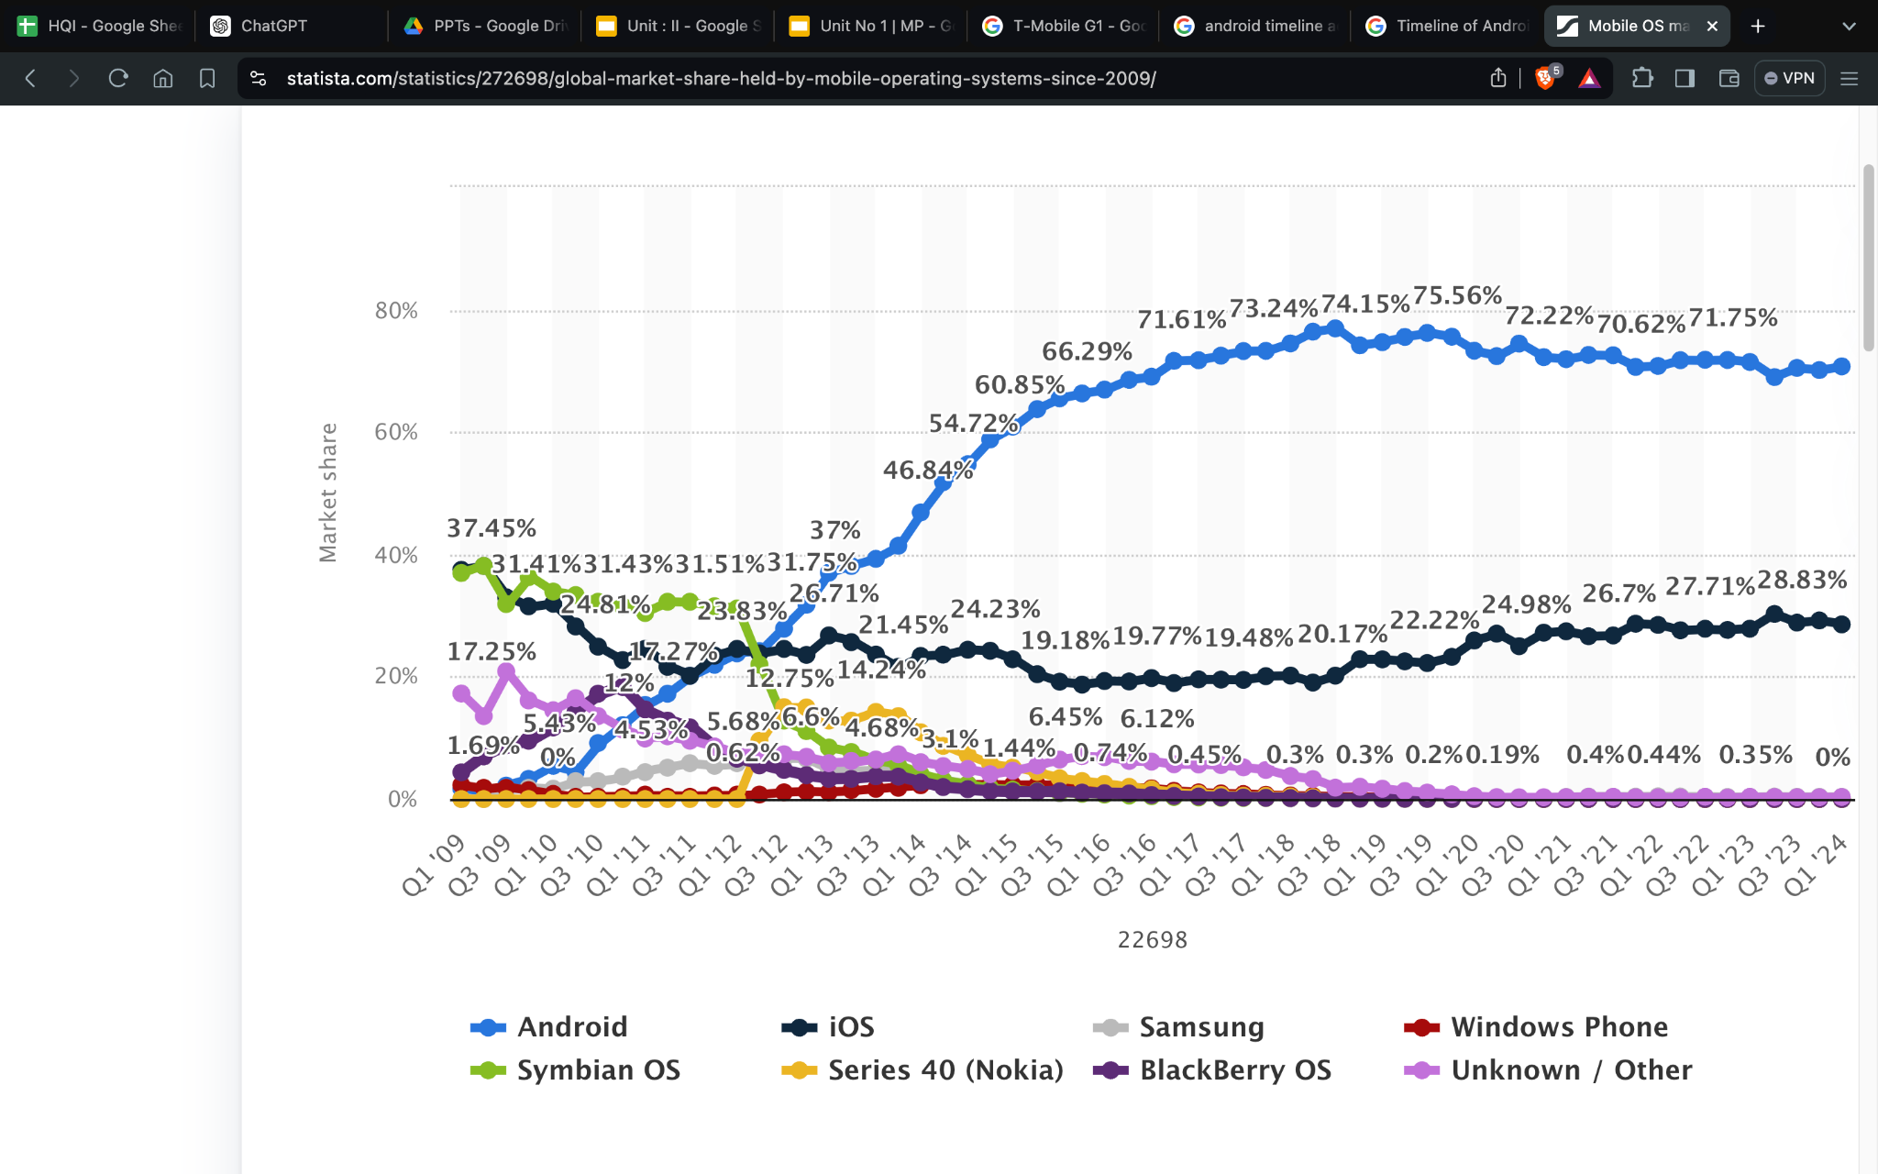

Slide 10
Versions of Android

Slide 11
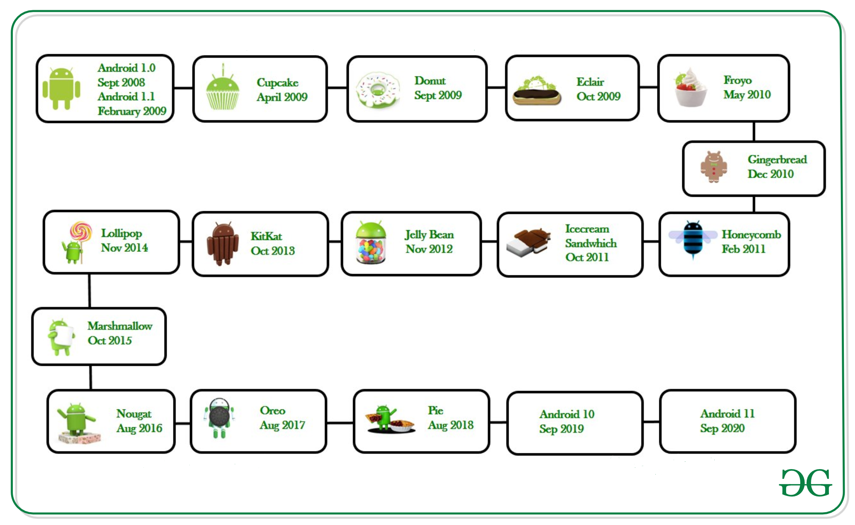

Slide 12
Cupcake (1.5) - First Commercial Release
Introduced the on-screen keyboard.
Support for widgets and third-party apps.
Laid the foundation for future updates and enhancements.

Slide 13
Donut (1.6) - Expanded Device Compatibility
Added support for different screen sizes and resolutions.
Introduced Quick Search Box and voice search.
Improved camera and gallery features.

Slide 14
Gingerbread (2.3) - Improved UI and Performance
Refined user interface for better speed and simplicity.
Enhanced gaming performance and support for more sensors.
Improved copy-paste functionality and battery management.

Slide 15
Ice Cream Sandwich (4.0) - Unified Phone and Tablet Interface
Combined features of Gingerbread and Honeycomb (tablet-specific version).
Introduced Holo theme for a consistent look across devices.
Improved multitasking, notifications, and facial recognition for unlocking.

Slide 16
Lollipop (5.0) - Material Design Introduction
Introduced Material Design, a new design language for a more intuitive and colorful user interface.
Enhanced notifications and battery-saving features.
Added support for 64-bit processors.

Slide 17
Marshmallow (6.0) - Enhanced Security and App Permissions
Introduced granular app permissions for better user control.
Added Doze mode for improved battery life during device inactivity.
Support for fingerprint recognition and USB Type-C.

Slide 18
Nougat (7.0) - Multi-Window Support
Added multi-window mode for running two apps simultaneously.
Improved notification system and quick settings customization.
Enhanced performance with the Vulkan API and seamless updates.

Slide 19
Oreo (8.0) - Improved Battery Life and Performance
Introduced Picture-in-Picture mode for multitasking.
Enhanced battery life with background process limits.
Notification channels for more control over notifications.

Slide 20
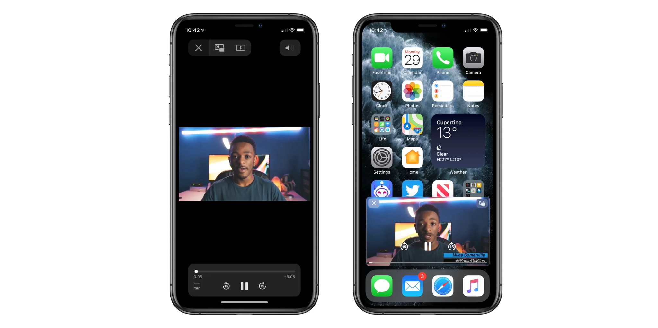

Slide 21
Pie (9.0) - Digital Wellbeing Features
Added Digital Wellbeing dashboard to help users manage screen time.
Gesture navigation for a more intuitive user experience.
Adaptive Battery and Adaptive Brightness for optimized performance.

Slide 22
Latest Release (e.g., Android 12 or 13) - Latest Features and Enhancements
Introduced new privacy features and revamped notification UI.
Improved performance, battery efficiency, and user customization options.
Enhanced support for foldable devices and 5G connectivity.

Slide 23
What Makes Android Unique

Slide 24
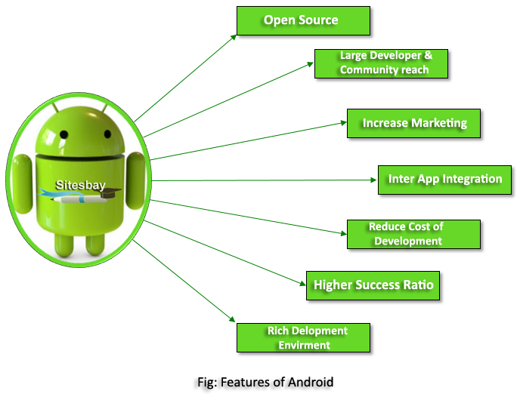

Slide 25
Customizable Home Screens and Widgets
Description: Android offers a high level of customization, allowing users to personalize their home screens with widgets, shortcuts, and various layouts.
Benefits: Users can tailor their device to their preferences, enhancing usability and functionality.
Extensive App Ecosystem via Google Play Store
Description: The Google Play Store provides access to millions of apps, games, books, movies, and other content.
Benefits: Users have a vast selection of applications for various needs, from productivity to entertainment.

Slide 26
Support for Multi-Tasking and Split-Screen
Description: Android supports multi-tasking, enabling users to run multiple apps simultaneously. Split-screen mode allows users to view and interact with two apps side by side.
Benefits: Enhances productivity by allowing users to perform multiple tasks without switching between apps.
Integration with Google Services (Gmail, Maps, Assistant)
Description: Android devices are seamlessly integrated with Google services, such as Gmail for email, Maps for navigation, and Google Assistant for voice commands and smart home control.
Benefits: Provides a cohesive and convenient experience, leveraging the power of Google’s ecosystem.

Slide 27
Security Features (Encryption, Google Play Protect)
Description: Android includes robust security features, such as device encryption and Google Play Protect, which scans apps for malware and security threats.
Benefits: Ensures user data and device integrity are protected from malicious threats.
Regular Updates and Enhancements
Description: Google regularly releases updates to the Android operating system, providing new features, performance improvements, and security patches.
Benefits: Keeps devices up-to-date with the latest technology and security measures, enhancing the overall user experience.

Slide 28
Open-Source Platform with Wide Developer Support
Description: Android is an open-source platform, meaning its source code is available for developers to modify and build upon.
Benefits: Encourages innovation and allows manufacturers to create custom versions of Android, leading to a diverse range of devices and user experiences.

Slide 29
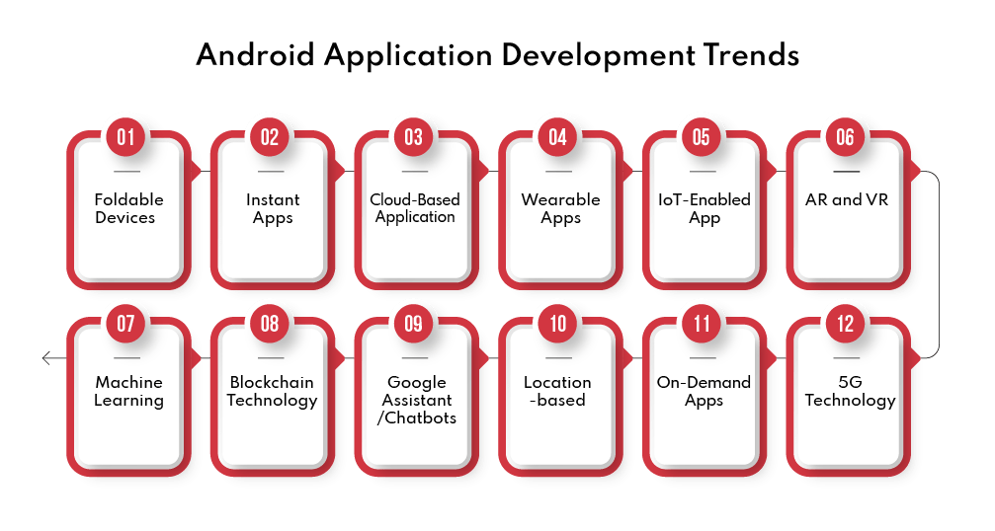

Slide 30
Advantages of Android

Slide 31
Open Source Platform
Freedom to Innovate
Description: Android is built on an open-source framework, allowing developers and manufacturers to access and modify its source code.
Benefits: Promotes innovation by enabling customization and development of unique features and functionalities.
Collaboration and Transparency
Description: Open-source nature fosters a collaborative environment among developers worldwide.
Benefits: Enhances the platform through collective contributions, leading to continuous improvement and evolution.
Reduced Development Costs
Description: No licensing fees for using Android.
Benefits: Reduces costs for manufacturers and developers, making it an attractive option for device production and app development.

Slide 32
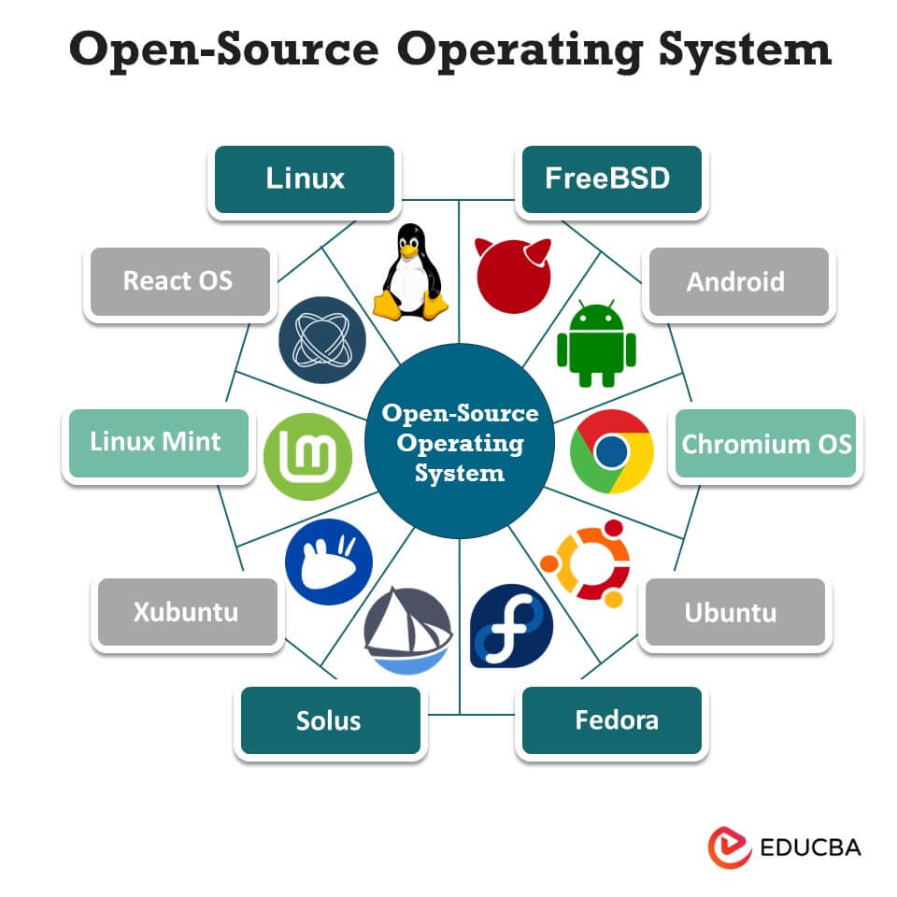

Slide 33
Large Developer Communit
Vibrant Ecosystem
Description: Android boasts one of the largest developer communities in the world.
Benefits: A vast number of developers contribute to the platform, creating a diverse and rich ecosystem of apps and services.
Resource Availability
Description: Abundance of resources such as tutorials, forums, and documentation.
Benefits: Facilitates learning and development, making it easier for new developers to get started and for experienced ones to advance their skills.
Continuous Innovation
Description: Large community drives constant innovation and the introduction of new features.
Benefits: Ensures that Android remains at the forefront of mobile technology advancements.

Slide 34
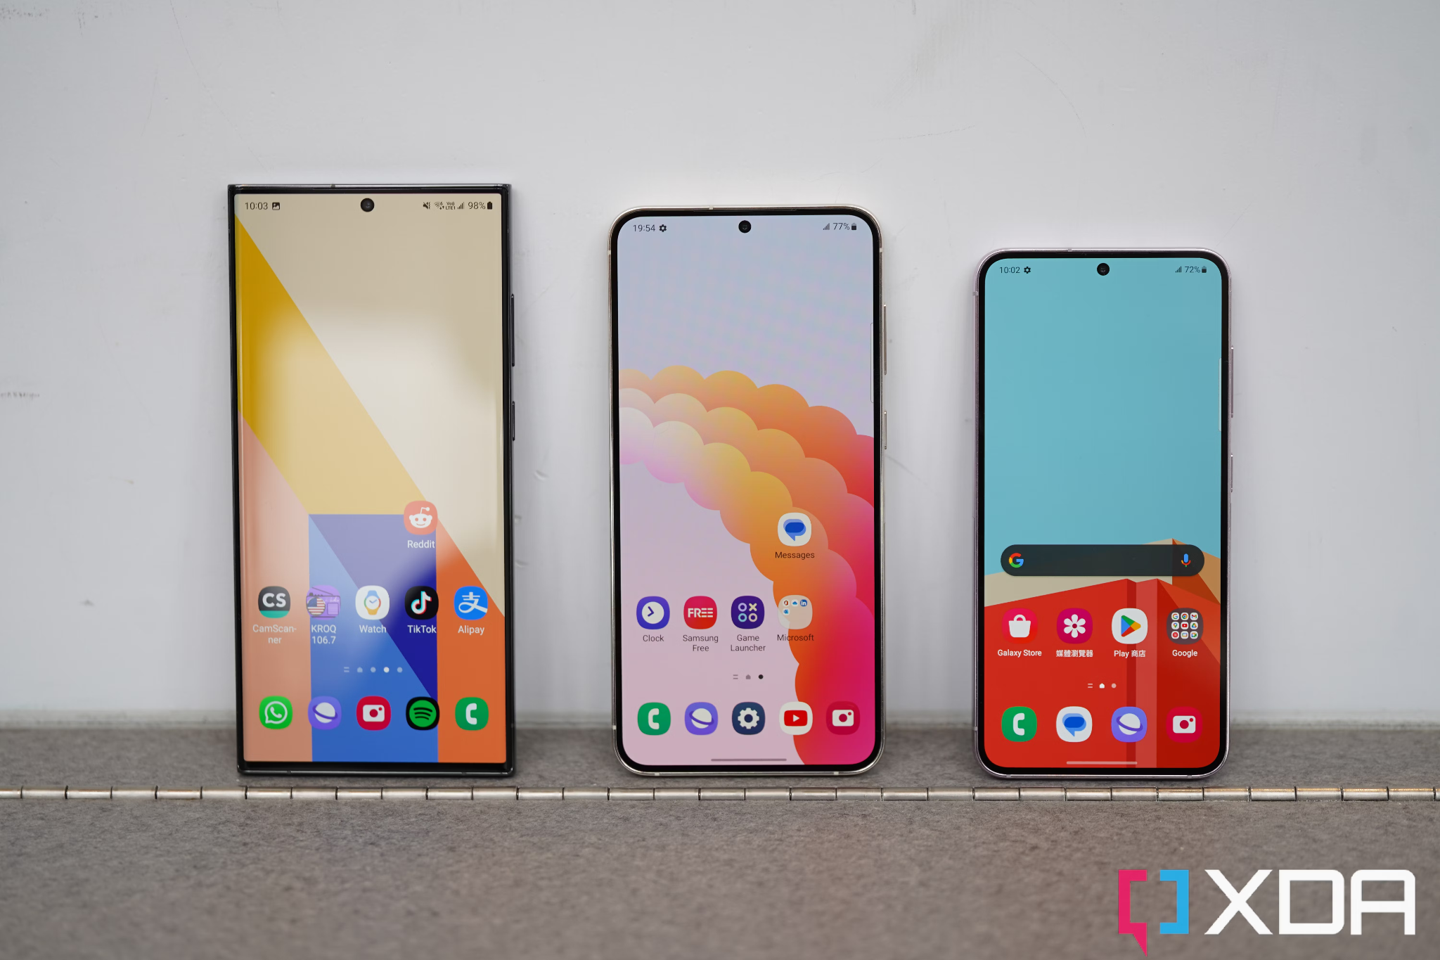

Slide 35
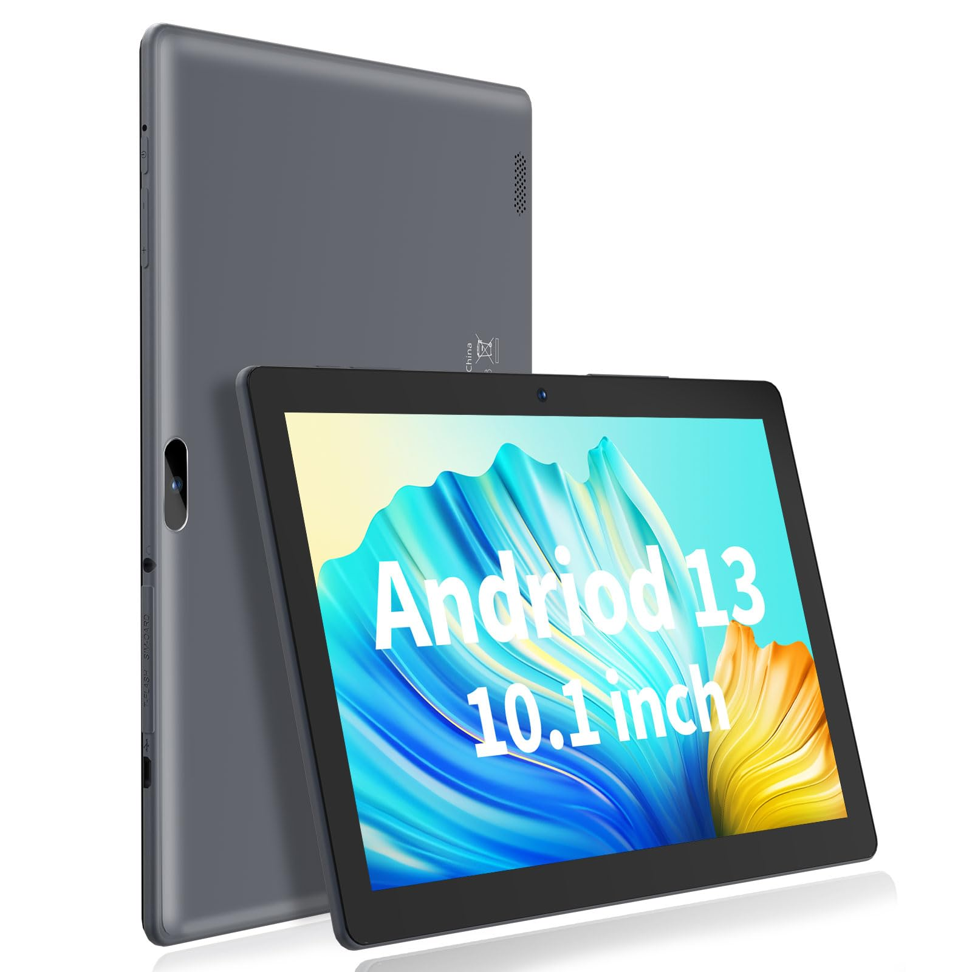

Slide 36
Extensive Device Compatibility
Wide Range of Devices
Description: Android runs on a vast array of devices, from budget smartphones to high-end tablets and smartwatches.
Benefits: Provides users with numerous choices, catering to different preferences and budgets.
Diverse Manufacturers
Description: Supported by various manufacturers like Samsung, LG, Sony, and many others.
Benefits: Encourages competition and innovation, leading to better products and features.
Integration with Emerging Technologies
Description: Compatible with emerging technologies such as IoT, smart home devices, and automotive systems.
Benefits: Ensures future-proofing and adaptability to new advancements.

Slide 37
High Customizability
Personalized User Experience
Description: Android allows users to customize their home screens, widgets, and overall interface.
Benefits: Enhances user satisfaction by providing a personalized experience tailored to individual preferences.
Custom ROMs and Themes
Description: Users can install custom ROMs and themes to modify the look and functionality of their devices.
Benefits: Offers advanced users the flexibility to optimize their devices according to their needs.
Flexible App Development
Description: Developers can create highly customizable apps that integrate seamlessly with the Android OS.
Benefits: Encourages the development of innovative and unique applications.

Slide 38
Strong App Market (Google Play Store)
Vast App Selection
Description: Google Play Store offers millions of apps, games, and other content.
Benefits: Provides users with a wide range of choices for entertainment, productivity, and more.
Developer-Friendly Policies
Description: Google Play Store supports developers with tools, analytics, and monetization options.
Benefits: Encourages developers to create and distribute high-quality apps, contributing to a thriving app ecosystem.
Security and Quality Control
Description: Google Play Protect and other security measures ensure that apps are safe and meet quality standards.
Benefits: Protects users from malware and ensures a reliable app experience.

Slide 39
Android Architecture

Slide 40
Overview of Android Architecture
Linux Kernel
Hardware Abstraction Layer (HAL)
Android Runtime (ART)
Native C/C++ Libraries
Java API Framework
System Apps

Slide 41
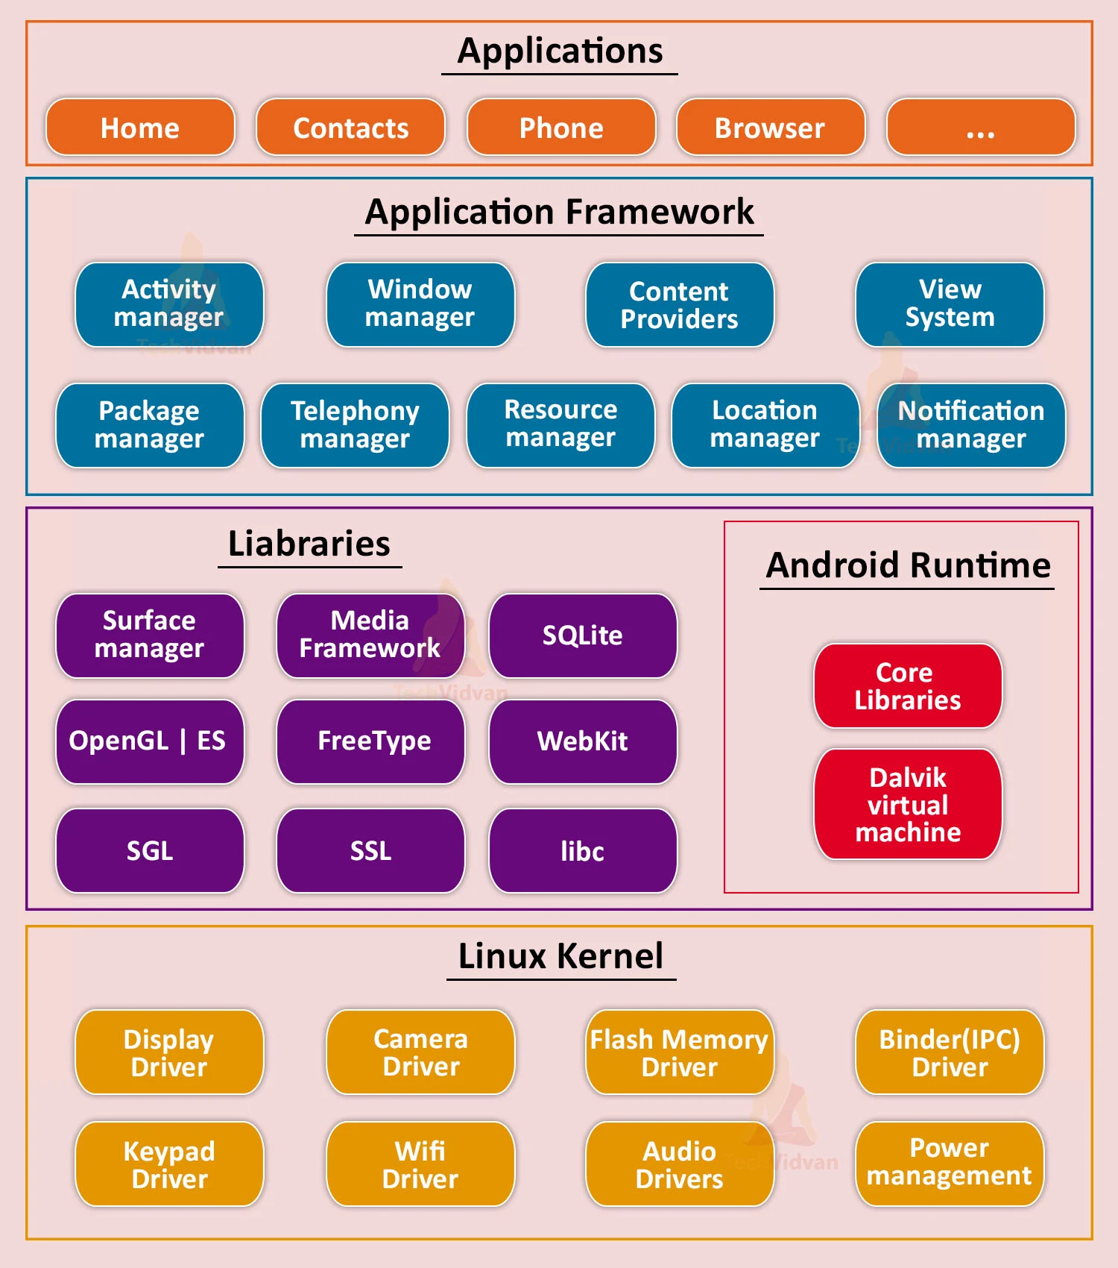

Slide 42
Core System Services
Description:
Memory Management: The Linux Kernel handles memory allocation and deallocation, ensuring that each process has the necessary memory resources and that memory is efficiently utilized.
Process Management: Manages the execution of processes, including scheduling, starting, and stopping processes. It ensures that CPU time is allocated fairly and efficiently among all running processes.
Network Stack: Provides the networking infrastructure, including protocols and interfaces, required for data communication over networks. It supports various network types such as Wi-Fi, Bluetooth, and cellular networks.

Slide 43
Importance of Memory Management
Preventing Overconsumption: Android devices have finite memory resources. Efficient memory management ensures that each application gets the memory it needs without exceeding limits. This prevents one app from consuming too much memory, which could otherwise lead to sluggish performance or even system crashes.
Optimizing Resource Usage: By managing memory efficiently, the Linux Kernel ensures that resources are used optimally. This includes reallocating memory dynamically as applications start and stop, ensuring that memory fragmentation is minimized, and that the system remains responsive.
Enhancing User Experience: Smooth multitasking and fast app switching rely on effective memory management. Users expect responsive performance, and proper memory allocation plays a critical role in meeting these expectations.

Slide 44
Process Management and Multitasking
Process management ensures fair and efficient use of the CPU among running applications:
Fair CPU Allocation: The Linux Kernel uses scheduling algorithms to allocate CPU time among processes fairly. This means that no single app can monopolize the CPU, ensuring that all applications get a chance to execute their tasks promptly.
Improving Responsiveness: Efficient process management enhances the responsiveness of the device. Users can run multiple apps simultaneously without experiencing delays or slowdowns, making multitasking seamless.
Prioritizing Tasks: Critical system tasks and user interactions are prioritized over background processes. This ensures that foreground apps, such as those currently in use or displaying notifications, receive immediate attention from the CPU.

Slide 45
Role of the Network Stack
The network stack is essential for enabling connectivity and facilitating communication between devices:
Managing Network Protocols: The Linux Kernel's network stack implements protocols such as TCP/IP, UDP, and others, which are essential for communication over the internet and local networks.
Handling Data Transmission: It manages the transmission and reception of data packets, ensuring reliable and efficient communication between applications and network endpoints.
Supporting Various Interfaces: The network stack supports a wide range of network interfaces, including Wi-Fi, cellular data, Bluetooth, and Ethernet. This versatility allows Android devices to connect seamlessly to different types of networks.
Ensuring Security: Security features within the network stack, such as encryption and authentication protocols, protect data transmission from unauthorized access and ensure the privacy of user information.

Slide 46
Benefits:
Efficient Resource Management: By managing memory and processes effectively, the Linux Kernel ensures that the system resources are used optimally, leading to better performance and responsiveness.
Stability: The robust management of system resources and processes contributes to the overall stability of the operating system, preventing crashes and ensuring smooth operation.

Slide 47
Hardware Abstraction Layer (HAL)

Slide 48
Interface Definition
Description:
Standardized Interface: The Hardware Abstraction Layer (HAL) defines a standardized set of interfaces that abstract the hardware functionalities. These interfaces provide a consistent way for the Android OS to interact with different hardware components.
Hardware Agnosticism: By abstracting hardware details through standardized interfaces, Android becomes hardware-agnostic. This means that the same Android OS can run on various devices with different hardware configurations without requiring modifications to the core OS.
Benefits:
Promotes Compatibility: Standard interfaces ensure that Android apps and system components can seamlessly interact with hardware, regardless of the device's specific hardware implementation.
Simplifies Development: Developers can write code that interacts with hardware using standardized APIs, reducing the complexity of supporting multiple hardware configurations.

Slide 49
Component-Specific HALs
Description:
Tailored Implementations: Each hardware component (e.g., camera, audio, sensors) has its own specific HAL implementation. These implementations are tailored to the unique characteristics and capabilities of each hardware component.
Optimized Performance: Component-specific HALs optimize performance by leveraging hardware-specific features and functionalities. For example, a camera HAL can utilize advanced camera features like image stabilization or HDR processing efficiently.
Benefits:
Enhanced Functionality: Optimized HALs ensure that hardware components operate at their full potential, providing users with enhanced functionality and performance.
Customization: Device manufacturers can customize HAL implementations to integrate proprietary hardware features or optimizations, further enhancing the device's capabilities.

Slide 50
Customization by OEMs
Description:
Flexibility for Manufacturers: OEMs have the flexibility to customize HAL implementations to meet specific hardware requirements or to differentiate their devices in the market.
Innovation and Differentiation: Customizing HALs allows manufacturers to innovate by introducing new features or optimizing hardware performance according to their unique design philosophies.
Device-Specific Optimization: OEMs can fine-tune HALs to achieve optimal performance and user experience on their devices, catering to specific market segments or use cases.
Benefits:
Market Differentiation: Custom HALs enable OEMs to differentiate their products from competitors by offering unique hardware capabilities or performance enhancements.
Adaptability: Manufacturers can quickly adapt Android to new hardware innovations or technological advancements by modifying HAL implementations, accelerating time-to-market for new devices.

Slide 51
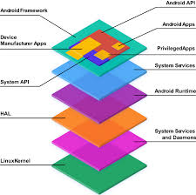

Slide 52
Android Runtime (ART)

Slide 53
Ahead-of-Time (AOT) Compilation
Description:
Process: ART (Android Runtime) employs Ahead-of-Time (AOT) compilation, where bytecode, typically used in Java applications, is converted into native machine code during the installation phase of an app.
Conversion: Unlike Just-in-Time (JIT) compilation, which compiles bytecode into native code at runtime, AOT compilation does this ahead of time, preparing the app to run more efficiently on the device.
Performance: This approach optimizes app performance by reducing the overhead associated with runtime bytecode interpretation and compilation, leading to faster execution and smoother user experience.
Benefits:
Improved App Performance: By converting bytecode into native code before execution, AOT compilation significantly reduces startup times and enhances overall app responsiveness.
Efficient Resource Utilization: Apps compiled with AOT consume less CPU and memory resources during runtime compared to JIT-compiled apps, contributing to better battery life and smoother multitasking.

Slide 54
Garbage Collection
Description:
Functionality: ART incorporates an advanced garbage collection system that manages the allocation and deallocation of memory within the Android environment.
Optimization: This system continuously monitors memory usage, identifying and reclaiming memory that is no longer in use or has become inaccessible (garbage).
Enhanced Management: By optimizing memory usage, the garbage collector prevents memory leaks and fragmentation, which can lead to app crashes or performance degradation over time.
Benefits:
Improved Memory Management: The optimized garbage collector ensures efficient utilization of memory resources, reducing the likelihood of memory-related issues that can impact app stability.
Enhanced Responsiveness: By maintaining optimal memory conditions, ART-supported apps operate more smoothly and respond more quickly to user interactions, enhancing the overall user experience.

Slide 55
Backward Compatibility
Description:
Transition from Dalvik: ART was introduced as a replacement for the Dalvik Virtual Machine in Android 5.0 (Lollipop) and later versions.
Support for Older Apps: To ensure compatibility with older apps originally developed for Dalvik, ART includes a runtime environment that can execute apps compiled with the older bytecode format.
Seamless Integration: This backward compatibility allows legacy apps to run on newer Android versions without requiring developers to update their codebases, preserving functionality and usability.
Benefits:
Continued App Support: ART’s ability to run apps compiled with Dalvik bytecode ensures that older applications remain functional and accessible to users even after Android OS updates.
Minimal Developer Effort: Developers do not need to recompile or modify their apps to take advantage of newer Android features or improvements, simplifying the transition to updated Android versions.

Slide 56
Native C/C++ Libraries

Slide 57
Performance-Critical Components
Description:
Key Libraries: Native C/C++ libraries such as WebKit for web rendering, OpenGL for graphics rendering, and SSL for security protocols are integral to handling performance-critical tasks.
Functionality: These libraries are optimized for high-performance operations, enabling tasks like rendering complex graphics, processing multimedia content, and securing data transmissions.
Benefits:
High-Performance Capabilities: Native C/C++ libraries provide efficient and optimized solutions for tasks that demand high computational performance, ensuring smooth and responsive user experiences.
Specialized Functionality: Each library specializes in a critical area—graphics rendering, web content display, or secure data transmission—contributing to the overall functionality and performance of Android applications.

Slide 58
Native Development Kit (NDK)
Description:
Purpose: The NDK allows developers to write performance-sensitive parts of their Android applications using native code, typically written in C or C++.
Usage: Developers leverage the NDK for tasks where performance is paramount, such as complex computations, intensive graphics rendering, or interfacing with hardware components.
Benefits:
Enhanced Performance: By using native code, developers can optimize performance-sensitive algorithms and operations, achieving better efficiency and responsiveness in their applications.
Access to Native APIs: The NDK grants access to platform-specific APIs and capabilities that may not be available or as efficient through Java or Kotlin, expanding the scope of what developers can achieve.

Slide 59
Standard Libraries
Description:
Inclusion: Android includes standard C libraries (libc) that provide fundamental system functionalities, such as memory allocation, input/output operations, and basic data structures.
Foundation: These libraries form the foundation for building robust and efficient applications on the Android platform, offering essential tools and utilities.
Benefits:
Robust Functionality: Standard C libraries ensure that developers have access to reliable and well-tested implementations of core system functionalities, promoting stability and compatibility across Android devices.
Efficiency: By leveraging standard C libraries, developers can implement common tasks with optimized and predictable performance, enhancing the overall efficiency of their applications.

Slide 60
Java API Framework

Slide 61
Rich API Set
Description:
Comprehensive Coverage: The Java API Framework provides a broad range of APIs tailored for Android app development. These include APIs for user interface (UI) design, location services, data storage, networking, multimedia, and more.
Pre-built Components: These APIs offer pre-built components and functionalities that developers can integrate into their applications, accelerating development and reducing the need for custom implementations.
Benefits:
Simplified Development: By offering a rich set of APIs, the Java API Framework simplifies app development. Developers can leverage ready-made solutions for common tasks, saving time and effort.
Consistency: The APIs ensure consistency in how developers interact with system functionalities, promoting uniformity in app behavior across different Android devices and versions.

Slide 62
Consistent API Interface
Description:
Stable Interface: The Java API Framework provides a stable and consistent interface for developers. This interface abstracts hardware-specific details, ensuring that apps behave predictably regardless of the underlying device hardware.
Cross-Device Compatibility: Developers can write code once using the Java API Framework, confident that their apps will function reliably across various Android devices, from smartphones to tablets and wearables.
Benefits:
Reduced Fragmentation: A consistent API interface reduces fragmentation by standardizing how apps interact with the Android platform. This simplifies app maintenance and updates, ensuring compatibility across a diverse ecosystem of devices.
Easier Adoption: New developers can quickly learn and adopt the Java API Framework, as its consistent structure and documentation make it accessible for building robust Android applications.

Slide 63
Inter-Process Communication (IPC)
Description:
Mechanisms: The Java API Framework includes mechanisms for Inter-Process Communication (IPC), such as the Binder framework. IPC facilitates communication between different processes within the Android system and between apps.
Secure and Efficient Communication: Binder ensures secure communication channels between components, enforcing permissions and allowing apps to share data and resources efficiently.
Benefits:
System Integration: IPC mechanisms enable apps to interact seamlessly with system services and other apps, supporting functionalities like sharing data, invoking services, and coordinating activities.
Security: Binder provides a secure environment for inter-process communication, protecting user data and system resources from unauthorized access or misuse.

Slide 64
System Apps

Slide 65
Core Functionality
Description:
Essential Apps: System apps include fundamental applications such as Phone, Contacts, Messages, Calendar, and Settings. These apps provide core functionalities necessary for everyday use.
Utility: They enable basic communication (Phone, Messages), contact management (Contacts), scheduling (Calendar), and device customization (Settings).
Benefits:
Out-of-the-Box Access: Pre-installed system apps ensure that users have immediate access to essential functionalities upon setting up their Android devices, enhancing convenience and usability.
Necessity: These apps form the backbone of user interaction with the device, ensuring that basic tasks like communication and organization are seamlessly integrated into the Android experience.

Slide 66
User Experience
Description:
Consistent Design: System apps are designed with a consistent user interface (UI) and user experience (UX) principles, ensuring familiarity and ease of use across different devices.
Intuitiveness: The design and functionality of system apps prioritize usability, making it straightforward for users to navigate and utilize core features.
Benefits:
Enhanced Satisfaction: A consistent and intuitive user experience across system apps enhances overall user satisfaction by minimizing learning curves and maximizing efficiency.
Accessibility: Users can quickly adapt to new Android devices or updates without significant relearning, thanks to the consistent design language and functionality of system apps.

Slide 67
Updateable via Google Play
Description:
Independent Updates: Many system apps, such as Calendar, Contacts, and Messages, can be updated separately through the Google Play Store.
Quick Updates: This approach allows developers to push updates and improvements to system apps independently of major Android OS updates.
Benefits:
Timely Enhancements: Users benefit from timely updates that introduce new features, security patches, and performance improvements without waiting for a full OS update cycle.
Flexibility: Google Play Store updates provide flexibility for app developers to iterate and innovate, continually enhancing user experience and addressing feedback.

